Slide 1
LOAN DEFAULTERS PREDICTION XYZ Corp.Ltd
20th January 2021
Group 1 - DSP 40 Andheri

Slide 2




EMERGING DATA SCIENTIST
MAJUSHREE RAGHWANI
HITESH VAZIR
ISMAIL SHAIKH
HARISH PISKA
Jane Doe
Jane Doe
Jane Doe
Jane Doe
B.Com in Banking & Insurance
PG Diploma in Banking Operations
M.Com
Diploma in Software & Hardware Networking
B.Com
Diploma in Hardware & Networking
Bsc.in chemistry
manju.shree86@gmail.com
hiteshinfotech007@gmail.com
ismail46h.shaikh@gmail.com
harishpiska@gmail.com
+91 8356094802
+91 8805483067
+91 7208466369
+91 9969455740

Slide 3
OVERVIEW OF THE DATASET
This dataset is all about the loan issued by the XYZ Corp. from the year 2007 to 2015. It provides Loan details along with the credit history, payment details, outstanding amount, defaulter, etc.
Dimension of the dataset: 855969 rows & 73 columns/variables.
Data set has Dependent variable called default_ind which has two classes 0 & 1, where 0 indicates non-defaulter and 1 indicates defaulter.
Dataset contains multiple data types like integer, float & objects.
This dataset consists with information regarding the current financial standing, previous credit history and some other variables of an individual or corporation who applies for a loan from A XYZ Corp as on Dec 2015.
Objective is to build such a model that can predict the probability of defaulter and non-defaulter using suitable machine learning algorithms which will help the company in deciding whether or not to pass the loan.

Slide 4
SOFTWARE’S USED
Free, open source & portable
Easy to write & read codes
Vast and powerful Libraries
Excellent output visualization
Good memory management
PYTHON
Data visualization
Implementation is easy
Can handle large amount of data
Quickly creates interactive plots
Drag & drop functionality
TABLEAU

Slide 5
LIBRARIES USED-PYTHON
Pandas
Pandas Profiling
NumPy
Matplotlib.pyplot
Seaborn
Sklearn
Sklearn.metrics
Sklearn.model_selection
Sklearn.linear_model
Sklearn.ensemble
Sklearn.tree
Pickle

Slide 6
PROCESS FOLLOWED
Explore the Data, analyze and understand the data.
Understand requirement of the XYZ Corp. Ltd and develop business sense of it.
Look out for Missing Values and treat them. Drop & Fill them wherever required.
Data Pre-Processing:
Check the shape of the data, data type of each variables, length.
Model Building based on various algorithm suitable for the data (Regression or Classification)
Convert categorical/object variables into numerical form with the help of Label Encoder.
Used Standard Scaler for for standardizing the complete data frame, except dependent variable (default_ind).
Splitting the data into Training & Testing datasets.
Further splitting both the data set into X & Y.
Try different algorithm
Tune the model
Finalize the Model based on Evaluation Matrix

Slide 7
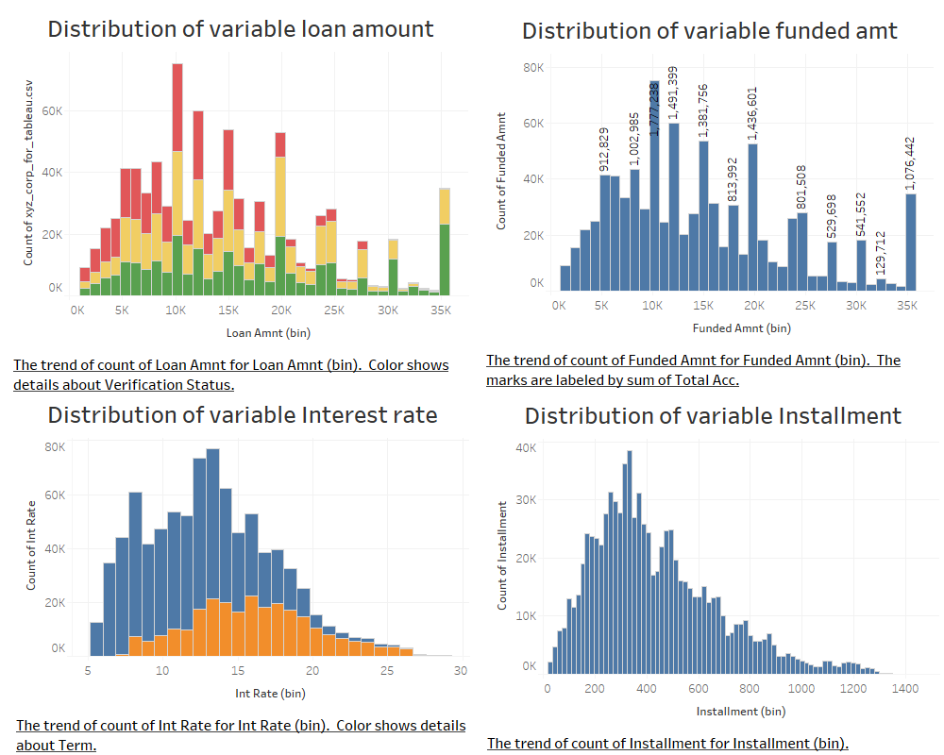

Slide 8
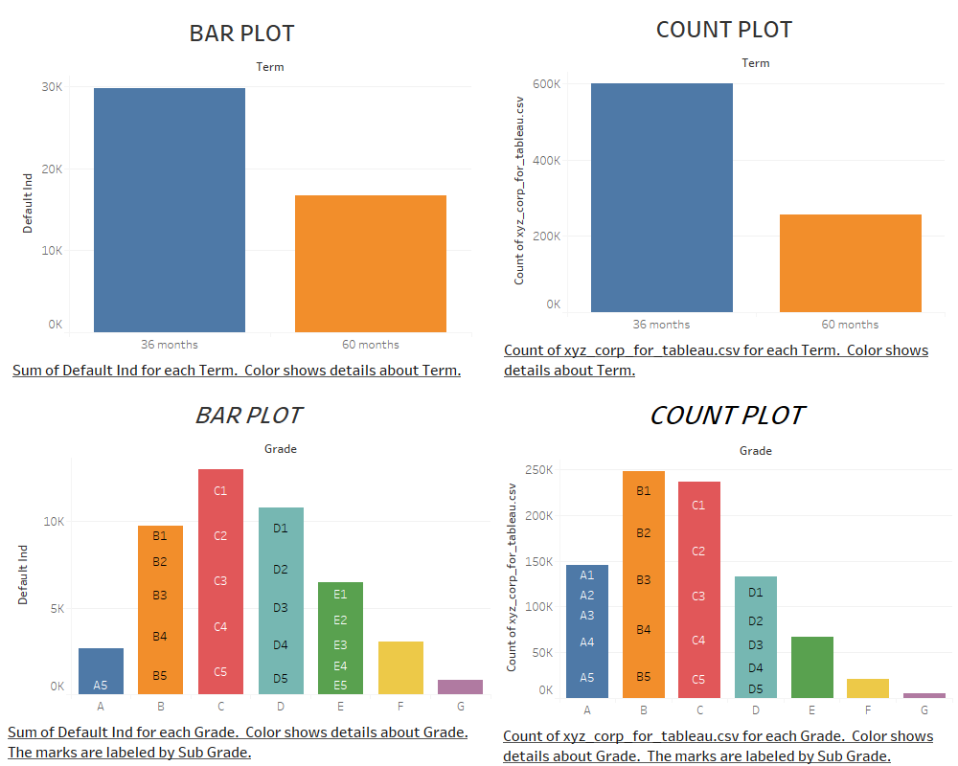

Slide 9
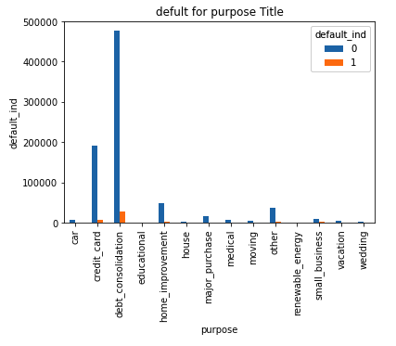
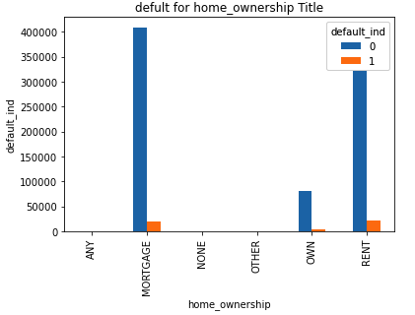
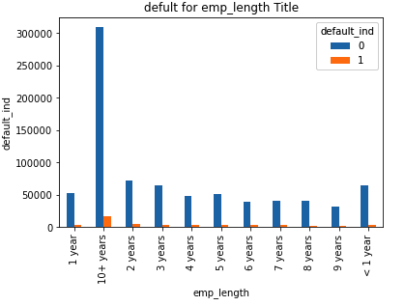
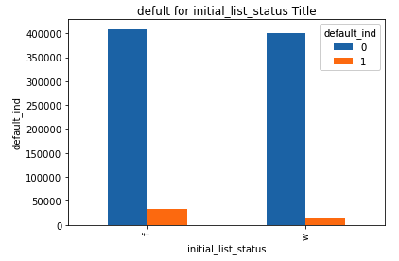
BAR PLOT

Slide 10
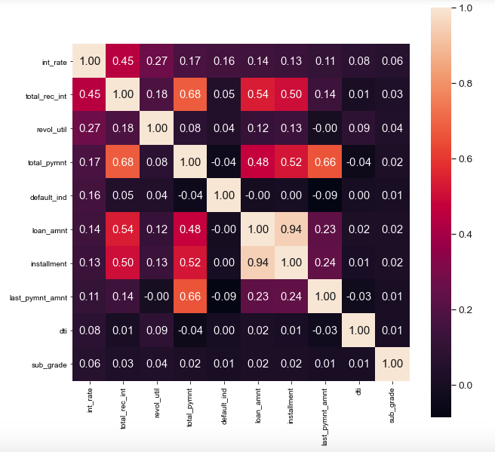

Slide 11
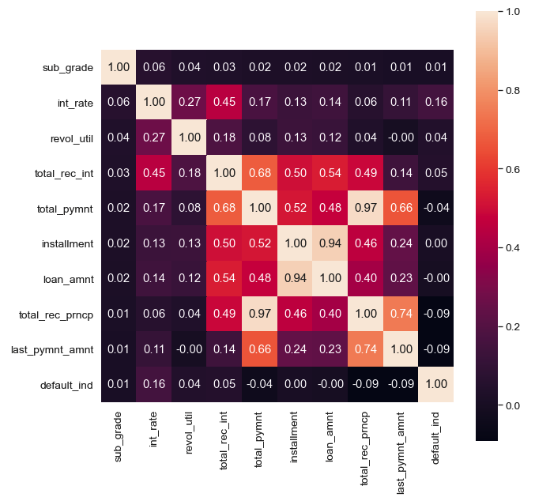

Slide 12
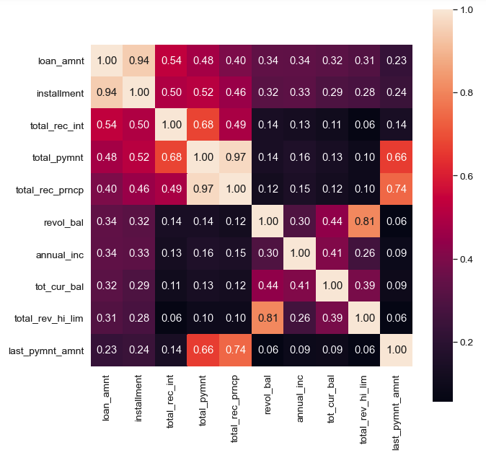

Slide 13
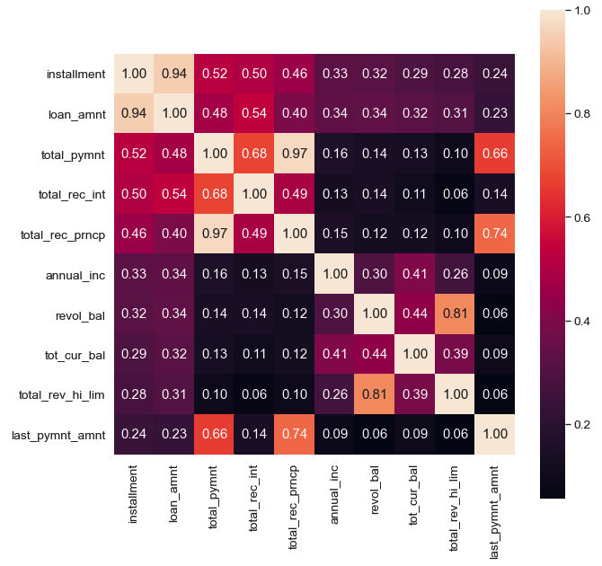

Slide 14
DATA PRE-PROCESSING
Eliminating Missing data:
Dropping variables with more than 50% of missing data. Total 22 variables have been dropped:
Dropping variables which are either less important as per Domain knowledge, not significant for the model or either a time-series data. Total 17 variables have been dropped under this category:

Slide 15

DATA PRE-PROCESSING
HANDLING MISSING DATA:
Variables with less than 50% of the missing values are replaced with Mean, Median or Mode based on data type of each variables.
emp_length – Mode
revol_util – Mean
tot_cur_bal – Mean
total_rev_hi_lim – Mean
collections_12_mths_ex_med – Mean
tot_coll_amt - Mean
VARIABLE LABELING:
“sub_grade” variable is the sub-part of “grade” variable. Which we further modified into numerical category only with help of “lambda” function.

Slide 16
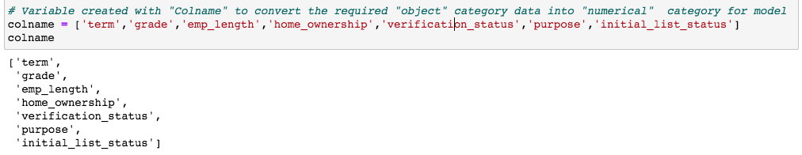
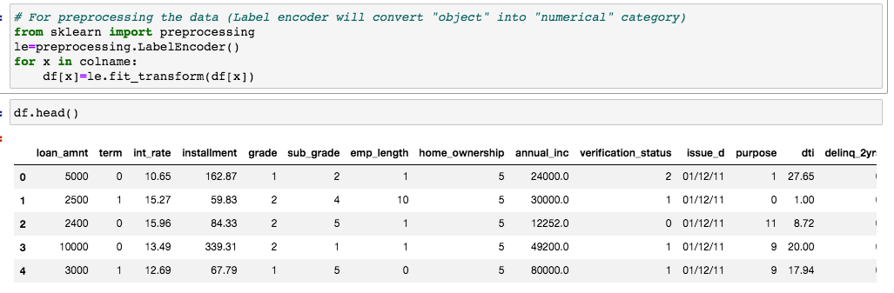
DATA PRE-PROCESSING
LABEL ENCODING:
Variable created with “colname" to convert the required "object" category variable into "numerical" category for using the same in model creation.

Slide 17
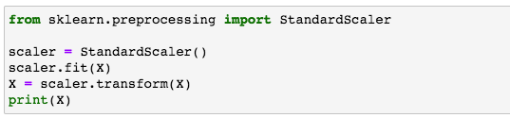
DATA PRE-PROCESSING
DATA / FEATURE SCALING:
Feature scaling or standardization is a step which is applied to independent variables orfeatures of the data. It basically helps to normalize the data within a particular range.
In this case, we used “StandardScaler” technique to standardize the data and use it for model preparation.

Slide 18
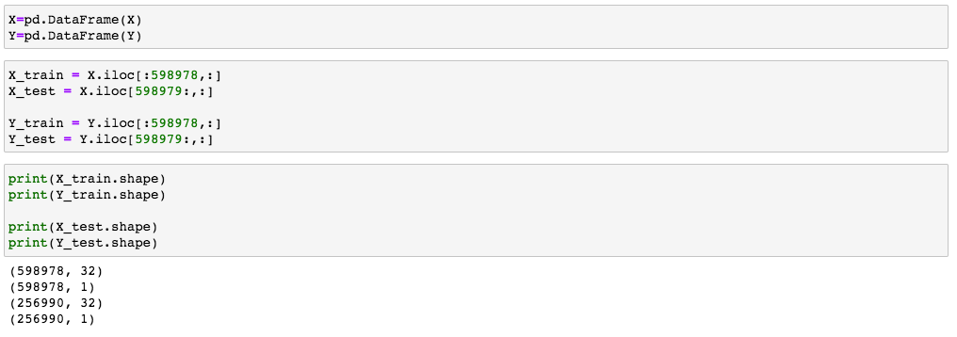
DATA PRE-PROCESSING
SPLITTING THE DATA INTO TRAINING & TESTING SET:
As per the information received from the client, splitting of the dataset in to be done based on “issue_d” column which is a loan issued date for a given range.
After splitting the data into training & testing set, ‘issue_d’ column has been dropped from both the data sets as it is a time series data and same is not required for running the model.

Slide 19
MODEL CREATION

Slide 20

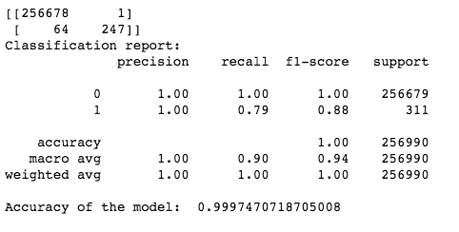
MODEL CREATION: DecisionTreeClassifier (Base Model)
Extremely Randomized Trees, is an ensemble ML algorithm.
The Extra Trees algorithm works by creating a large number of un-pruned decision trees from the training dataset. Predictions are made by averaging the prediction of the decision trees in the case of regression or using majority voting in the case of classification.
Model can be tuned based on 3 factors; they are the number of decision trees in the ensemble, the number of input features to randomly select and consider for each split point, and the minimum number of samples required in a node to create a new split point.
Evaluation of Base Model:

Slide 21
Models Comparison
Particulars | Logistic Regression | Gradient Boosting Classifier | Extra Tree Classifier | Random Forest Classifier | Decision Tree Classifier
Base Accuracy | 99.52% | 99.97% | 61.63% | 99.97% | 99.97%
Recall – 0 | 1.00 | 1.00 | 0.62 | 1.00 | 1.00
Recall – 1 | 0.80 | 0.79 | 0.97 | 0.79 | 0.79
F1 Score – 0 | 1.00 | 1.00 | 0.76 | 1.00 | 1.00
F1 Score – 1 | 0.80 | 0.86 | 0.01 | 0.86 | 0.88
Tuned Accuracy | 99.97% | - | - | - | -
Recall – 0 | 1.00 | - | - | - | -
Recall – 1 | 0.79 | - | - | - | -
F1 Score – 0 | 1.00 | - | - | - | -
F1 Score – 1 | 0.86 | - | - | - | -
Type I – Error(count) | 15 | 15 | 98956 | 15 | 1
Type II – Error(count) | 66 | 66 | 9 | 66 | 64
0 = Non-Defaulters, 1 = Defaulters

Slide 22
CONCLUSION
We Have Compared five Different models from which Decision Trees Classifier was Giving Better Accuracy w.r.t class of importance for both individual classes, So we had Finalize DecisionTreesClassifier model with the Accuracy of 99.97%.
Here we Concluded this Model as a better model for Loan Default Prediction.

Slide 23
Thank you…

